Slide 1
Experts & Electronically-Stored Information under Federal & Virgin Islands Rules of Evidence
Presented by
Prof. Cynthia E. Jones
January, 2019
District Court of the Virgin Islands
10th Annual District Court Conference
1

Slide 2
Overview
I. Electronically-Stored Information (ESI)
Virgin Islands Rules of Evidence (3/31/2017)
Recent Changes to the Federal Rules of Evidence (12/1/2017)
Ancient Documents [Rule 803(16)]
Self Authentication of ESI [FRE 902(13)]
Self Authentication of ESI [FRE 902(14)]
II. Expert Testimony & Forensic Evidence
2

Slide 3
You Should Have:
Inadmissible
Handout Materials on the Virgin Islands Rules of Evidence (V.I.R.E.)
Admissible
3

Slide 4
Hearsay Review
Pop Quiz!
Boyfriend v. Husband
In a wrongful death civil action, the estate of Boyfriend contends that when Husband learned of his wife’s affair with Boyfriend, Husband attacked Boyfriend from behind and fled. Husband denies being the attacker and objects to statements made by Boyfriend on hearsay grounds.
4

Slide 5
Vote now on the hearsay objection
Inadmissible
Admissible
Boyfriend’s statements to the cop are inadmissible hearsay.
Boyfriend’s statements are admissible under a hearsay exception
5

Slide 6
Admissibility Analysis
Prior Identification??? [Rule 801(d)(1)(c)]
Confrontation Clause???? [Sixth Amend.]
Excited Utterance??? [Rule 803(2)]
Dying Declaration??? [Rule 804(b)(2)]
Present Sense Impression??? [Rule 803 (1)]
6

Slide 7
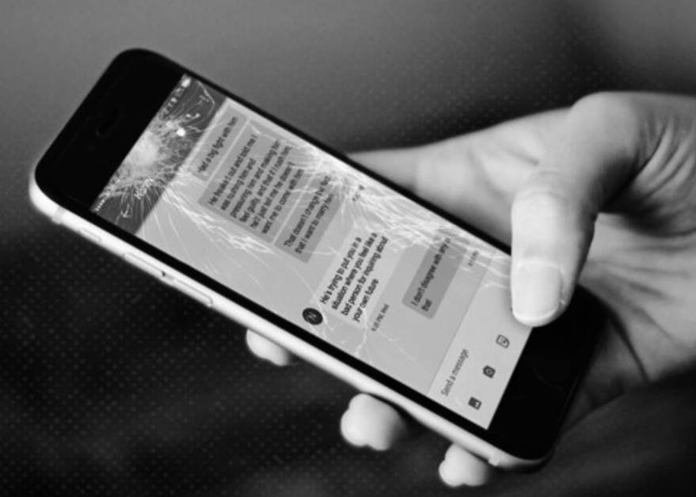
The Admissibility & Authentication of
Electronically-Stored Information (ESI)
7

Slide 8
Ancient Documents: FRE 803 (16)
Old Rule
The following are not excluded by the rule against hearsay, regardless of whether the declarant is available as a witness:
(16) Statements in Ancient Documents.
A statement in a document that is at least 20 years old and whose authenticity is established.
New Rule
(as of 12/1/17)
The following are not excluded by the rule against hearsay, regardless of whether the declarant is available as a witness:
(16) Statements in Ancient Documents. A statement in a document that is at least 20 years
old that was prepared before January 1, 1998 and whose authenticity is established.
8

Slide 9
FRE 803(16): Ancient Documents
FRE Committee Report on Ancient Documents Revision
“Given the exponential development and growth of electronic information around the year 1998, the hearsay exception for ancient documents has now become a possible open door for large amounts of unreliable ESI, as no showing of reliability needs to be made to qualify under the exception.”
9

Slide 10
V.I.R.E. 803 (16):
Statements in Ancient Documents
“A statement in a document that is at least 20 years old and whose authenticity is established.”
In Re Adoption of Virgin Islands Rules of Evidence, Supreme Court of the Virgin Islands, 2017 WL 1293843
(adopting the V.I.R.E., effective March 31, 2017).
As of 2019, all documents & ESI in existence in 1999 and before could be admissible under the Ancient Documents exception
10

Slide 11
Article 9: Authentication of ESI
Authentication is a fairly low standard
The possibility of alteration does not and cannot be the basis for excluding ESI as unauthenticated as a matter of course.”
Court needs only find that proponent has put forth enough evidence for a jury to find the item is what it purports to be; usually a live witness familiar with the object
Text messages, Facebook posts, email messages, as well as other potential evidence captured on servers, websites, computers, laptops, tablets and phones
11

Slide 12
FRE 902 (13)
Self-Authentication
(effective 12/1/2017)
New Rule
Rule 902. Evidence That Is Self-Authenticating
The following items of evidence are self-authenticating; they require no extrinsic evidence of authenticity in order to be admitted:
(13) Certified Records Generated by an Electronic Process or System.
A record generated by an electronic process or system that produces an accurate result, as shown by a certification of a qualified person that complies with the certification requirements of Rule 902(11) or (12). The proponent must also meet the notice requirements of Rule 902(11).
12

Slide 13
ESI Authentication
FRE 902 (13): “A record generated by an electronic process or system that produces an accurate result…”
Proving that a server was used to connect to a particular webpage.
Commonly and routinely, servers have an Internet Information Services (IIS) log that automatically records information about every internet connection routed to the web server to view a web page, including the IP address, webpage, user agent string and what was viewed or requested on the website.
13

Slide 14
ESI Authentication Examples
FRE 902 (13): “A record generated by an electronic process or system that produces an accurate result…”
Proving that a USB drive was used on a particular computer
Windows operating system, which automatically records information about every USB device connected to her computer in a database known as the “Windows registry.” The Windows registry database is maintained on the computer by the Windows operating system in order to facilitate the computer’s operations.
14

Slide 15
FRE 902 (14)
Self Authentication
(effective December 1, 2017)
New Rule
Rule 902. Evidence That Is Self-Authenticating
The following items of evidence are self-authenticating; they require no extrinsic evidence of authenticity in order to be admitted:
(14) Certified Data Copied from an Electronic Device, Storage Medium, or File. Data copied from an electronic device, storage medium, or file, if authenticated by a process of digital identification, as shown by a certification of a qualified person that complies with the certification requirements of Rule 902(11) or (12). The proponent also must meet the notice requirements of Rule 902(11).
15

Slide 16
Authentication of ESI under the FRE
A teenage girl (Molly Preston) claims she was raped by the man who also killed her mother. Molly also claims she had no prior contact with the man.
16

Slide 17
Authentication of ESI under FRE
Molly Preston is accused of going online to solicit someone to kill her mother in exchange for sexual favors. The government obtains a copy of the girl’s Facebook-like “BeFriendz” page which has incriminating information.
17

Slide 18
Requirements for Self-Authentication under FRE 902(13) & (14)
Before FRE 902(13) & (14)
Forensic tech would need to testify at trial and explain the technical process used to generate the information or produce the electronic files
Under FRE 902(13) & (14)
The ESI would be self-authenticating if the proponent obtains
a written certification from a qualified tech, and
provides advance notice to opposing counsel.
18

Slide 19
19

Slide 20
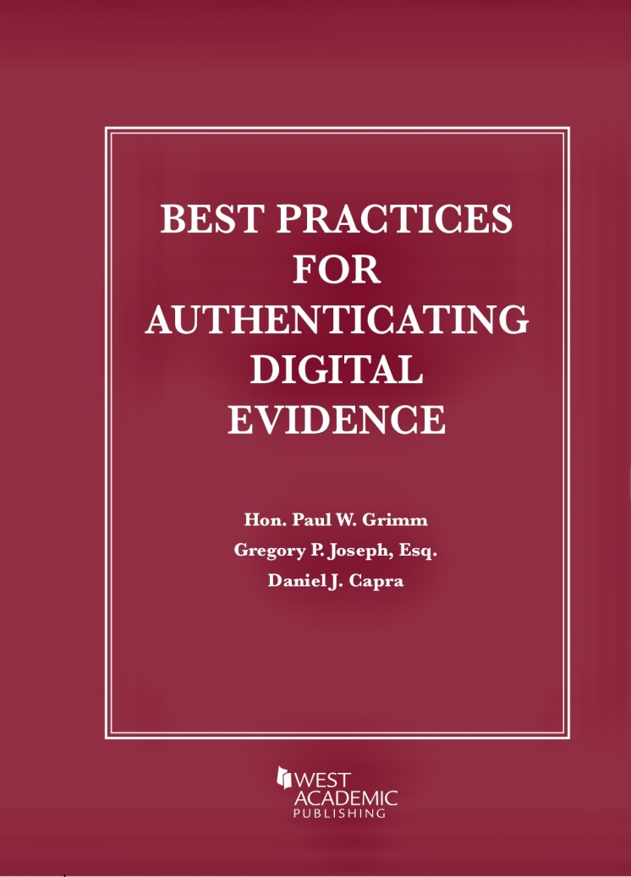
Virgin Islands Evidence Rules
The V.I.R.E. does not have 902(13) & (14). Thus, a forensics technician would be needed to authenticate the ESI at trial
20

Slide 21
Pop Quiz!
Virgin Islands Rules of Evidence
Julia, a young woman on vacation in the USVI, meets “C-Square”, a famous pop star, and agrees to hang out with him in his hotel room. Julia later reported that C-Square sexually assaulted her. The USVI prosecutor has filed rape charges against C-Square. The defense has moved in limine to exclude any testimony regarding another woman, Tina.
21

Slide 22
The prosecution argues that under the rules of evidence the Tina incident is admissible to prove C-Squared raped Julia. The defense objects.
What ruling under the V.I.R.E.?
Inadmissible
Admissible
22

Slide 23
Inadmissible!
FRE 413 states:
“In a criminal case in which a defendant is accused of a sexual assault, the court may admit evidence that the defendant committed any other sexual assault. The evidence may be considered on any matter to which it is relevant.”
The local V.I.R.E. has not adopted the sexual propensity rules 413, 414 and 415 regarding a defendant’s prior sexual history.
23

Slide 24
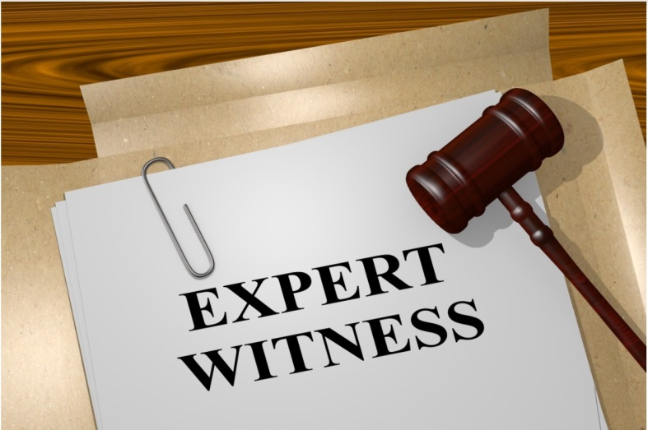
Expert Witnesses
& Forensic Evidence
24

Slide 25
FRE 702. Testimony by Expert Witnesses
A witness who is qualified as an expert by knowledge, skill, experience, training, or education may testify in the form of an opinion or otherwise if:
(a) the expert’s scientific, technical, or other specialized knowledge will help the trier of fact to understand the evidence or to determine a fact in issue;
(b) the testimony is based on sufficient facts or data;
(c) the testimony is the product of reliable principles and methods; and
(d) the expert has reliably applied the principles and methods to the facts of the case.
25

Slide 26
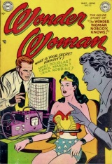
Frye vs Daubert
Frye (1923)
General Acceptance Test
“[W]hile courts will go a long way in admitting expert testimony deduced from a well-recognized scientific principle, [it] must be sufficiently established to have gained general acceptance in the particular field in which it belongs.”
Daubert (1993)
Reliability Standard
Trial judge determines whether the testimony rests on a reliable foundation.
“the trial judge must determine . . . whether the reasoning or methodology underlying the testimony is scientifically valid.”
FRE (1975)
26

Slide 27
Reliability or Daubert factors
(1) Whether the theory or technique in question has been or can be tested or duplicated
(2) Whether the theory or technique has been subjected to peer review or publication?
(3) The known or potential rate of error of the particular theory or technique, and whether means exist for controlling its operation?
(4) The extent to which the theory or technique has been accepted by others in the field (Frye).
27

Slide 28
The Scope and Reach of Daubert
General Electric v. Joiner (1997); Kumho Tire Co, LTD v. Carmichael (1999); Weisgram v. Marley (2000)
1. Reliability→ sufficient empirical data to support the specific theory or technique
2. Daubert factors→ apply equally to scientific, technical or specialized
3. Expert Opinion→ knowledge and fact vs subjective opinion and speculation
28

Slide 29
Expert Testimony in the USVI
I. V.I.R.E. 702 (same language as the FRE)
II. Daubert Standard Applies in USVI (2016)
Antilles School v. Lembach, Supreme Court of the Virgin Islands, 2016 WL 948969.
(Rejecting Frye general acceptance test, stating “we join the vast majority of jurisdictions in holding that the more liberal Daubert standard should govern the admission of expert testimony in the Virgin Islands.” )
29

Slide 30
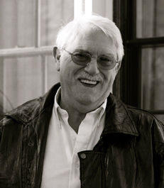
Expert Testimony & Wrongful Convictions
Since 1989, 2,363 prisoners have been exonerated of murder or another serious felony and 553 (25%) were convicted with flawed or misleading forensic evidence. National Registry of Exonerations
The expert testified that the crime scene hair sample “was unlikely to match anyone” other than the defendant, Edward Honaker. Honaker was later exonerated by DNA testing.
30

Slide 31
The National Academy of Science Report (2009) “Strengthening Forensic Science in the United States: A Path Forward
Questioned: the accuracy, reliability, and validity of non-DNA forensic feature comparison analysis; forensic expert testimony appears to be based more on subjectivity than science
Concluded: “Much forensic evidence— including, for example, bite marks and firearm and tool mark identifications —is introduced in criminal trials without any meaningful scientific validation, determination of error rates, or reliability testing to explain the limits of the discipline”
31

Slide 32
President’s Council of Advisors on Science and Technology (“PCAST Report”) (2016)
Found:
1. Experts are testifying to conclusions not validated by the current state of the science. All results for every forensic science method should indicate the degree uncertainty based on empirical data
“I have determined to a reasonable degree of scientific certainty that the shoe imprint matches the defendant”
“I am 100% certain; fingerprints have a zero percent error rate”
“There is a 1 in 11 million chance that this hair sample would match anyone other than the defendant”
32

Slide 33
Reaction from the Bench
Judicial Restrictions on Forensic Expert Testimony:
I. Preclude the forensic expert from expressing false certainty or presenting statistical probabilities unsupported by research
II. Preclude Individualization
In some state and federal cases, trial courts have allowed the examiner to testify only that the evidentiary sample shares characteristics and similarities with the defendant or an item linked to the defendant, especially in cases involving found that forensic document examinations, handwriting analysis, and ballistics
33

Slide 34
DOJ “Uniform Language” Standards for Forensic Experts
(fiber, firearms, fingerprints, hair—2018-19)
An examiner shall not testify/prepare a report which states :
two samples originated from the same source to the exclusion of all other sources
Results are “infallible or has a zero error rate”
Provide a conclusion that includes a numerical degree of probability except when based on relevant and appropriate data
state cite the number of times he/she has performed similar test “as a direct measure for the accuracy of a proffered conclusion”
use expressions like “reasonable degree of scientific certainty”
34

Slide 35
DOJ “Uniform Language” Standards for Forensic Experts
(fiber, firearms, fingerprints, hair—2018-19)
Experts can/should frame their conclusions as:
Inclusion--“an examiner’s conclusion that the source of the known . . . sample can be included as a possible source”
Exclusion: “the source of the known sample cannot be included as a possible source of the questioned sample.”
Inconclusive: “no determination can be reached”
35

Slide 36
Forensic Feature Comparison Analysis
The State of Affairs:
Under Daubert, and based on the current state of forensic science, can a forensic expert testify reliably and accurately that an evidentiary sample originated from or is associated with a known source?
Pretrial Daubert hearing where trial judges determine, among other things:
1. Is the “Science” Valid?
2. If so, are there limitations that should imposed on the expert’s testimony?
36

Slide 37
Daubert Hearing #1
A young girl is killed in the laundry room of her apartment building. The prosecution intends to prove that the victim was killed with a plastic bag that has been linked to the defendant. The defense moves to exclude the testimony regarding the plastic bag.
37

Slide 38
What Are the Potential Challenges to this Expert Testimony?
1. Is the science valid?
2. If so, are there limitations that should be imposed on the expert’s testimony?
38

Slide 39
Daubert Hearing #2
The government seeks to establish that the defendant’s identity as the Michael Laszlo who committed war crimes by torturing people while serving as a guard in a concentration camp in Budapest. The defense moves pretrial to exclude or restrict the testimony of the government’s forensic document examiner.
39

Slide 40
What Are the Potential Challenges to this Expert Testimony?
1. Is the science valid?
2. If so, are there limitations that should be imposed on the expert’s testimony?
40

Slide 41
Daubert Hearing #3
A woman is charged with arson for setting the fire in her apartment that killed her quadriplegic son. The government calls an expert to link the defendant to the accelerant used to set the fire.
41

Slide 42
What Are the Potential Challenges to this Expert Testimony?
1. Is the science valid?
2. If so, are there limitations that should be imposed on the expert’s testimony?
42

Slide 43
The End
Please pass the Index Cards
forward for collection
I hope you enjoyed the presentation !
-Prof. Cynthia Jones
43

